Slide 1
NLP: Let the Machine Do the Reading
Word Embeddings

Slide 2
Overview
Word embeddings are used in most of the NLP tasks, whenever we are working with text. It is a way of encoding the words into numbers.
By the end of this session you will be able to:
Identify the key concepts of word representations
Generate word embeddings
Prepare text for machine learning
Implement the continuous bag-of-words (CBOW) model

Slide 3
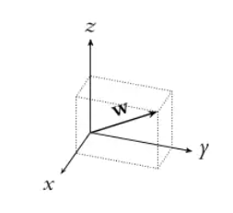
What is Word Embeddings?
Also known as word vectors
Word embeddings are real-number vectors that represent words from a set of words or vocabulary
Word embeddings allow us to implicitly include external information from the world into our language understanding models

Slide 4
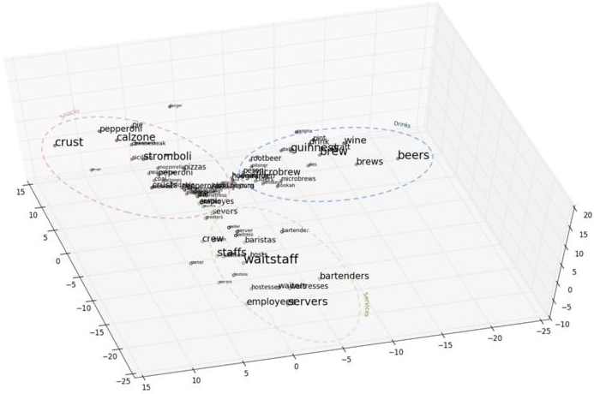
What is Word Embeddings?

Slide 5
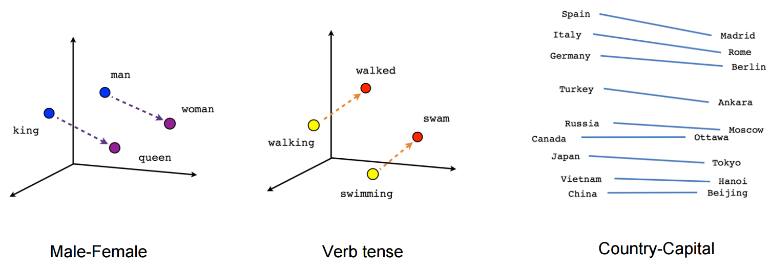
What is Word Embeddings?

Slide 6
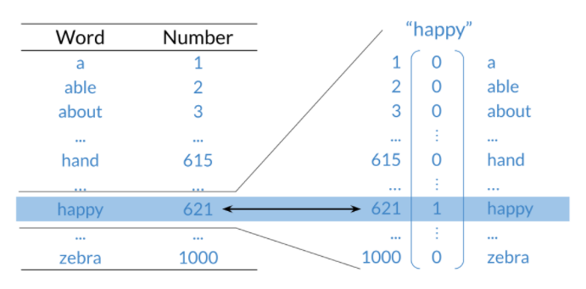
Basic Word Representation
We can represent words in few different ways:
Integers
One-hot vectors
Word Embeddings

Slide 7
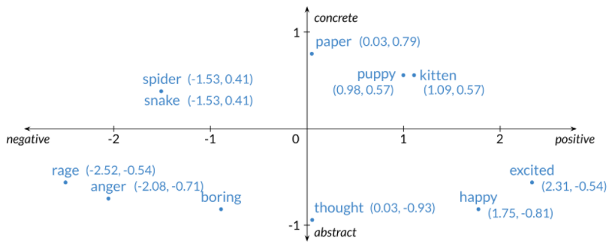
Word Embeddings

Slide 8
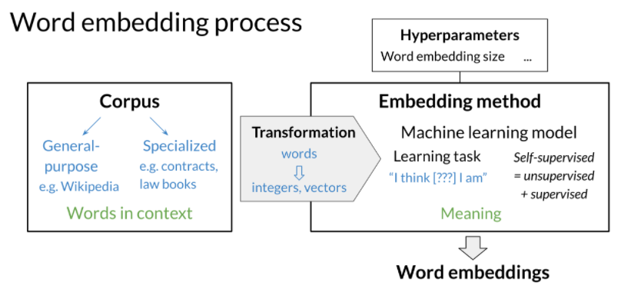
How to Create Word Embeddings?

Slide 9
Word Embedding Methods
Classical, for example:
Word2Vec by Google, 2013
Continuous bag-of-words (CBOW)
Continuous skip-gram
Global Vectors (GloVe) by Stanford, 2014
fastText by Facebook, 2016
Advanced deep learning, for example:
BERT by Google, 2018
ELMo by Allen Institute for AI, 2018
GPT-2 by OpenAI, 2018

Slide 10
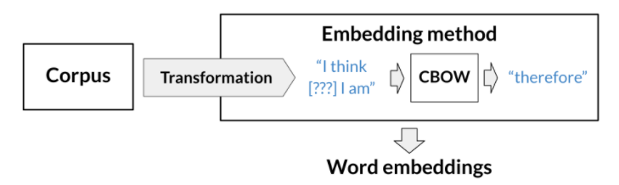
Continuous bag-of-words (CBOW)

Slide 11
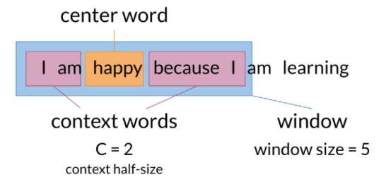
Continuous bag-of-words (CBOW)
Here is a visualization that shows you how the models works:

Slide 12
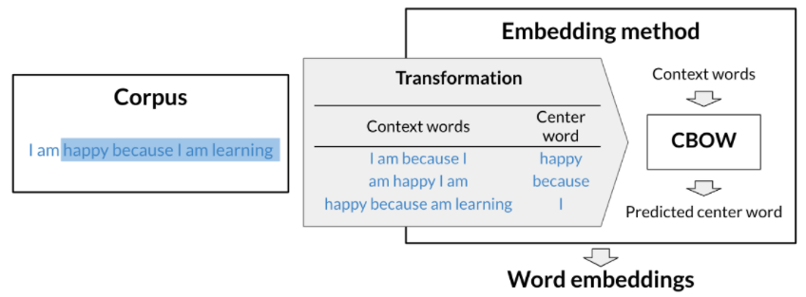
Continuous bag-of-words (CBOW)

Slide 13

Cleaning and Tokenization
Letter case: “the” == “The” == “THE” -> lower/upper case
Punctuation: . ! , ? -> . (dot)
Numbers: 1 2 3 4 5 -> remove
Special characters: $ @ -> remove
Special words: #NLP -> :happy: #nlp

Slide 14
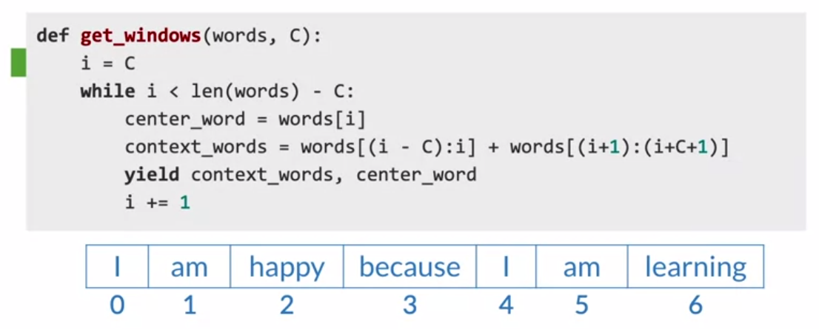
Sliding Window of Words

Slide 15
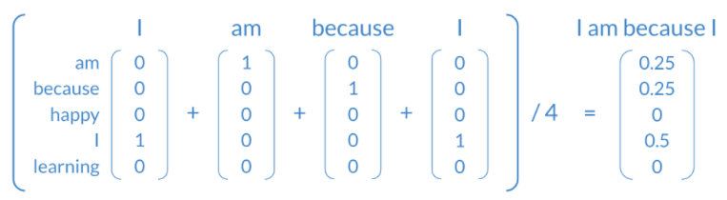
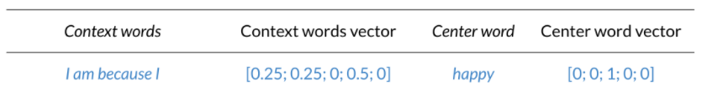
Transforming Words into Vectors
To transform the context vectors into one single vector, you can use the following:

Slide 16
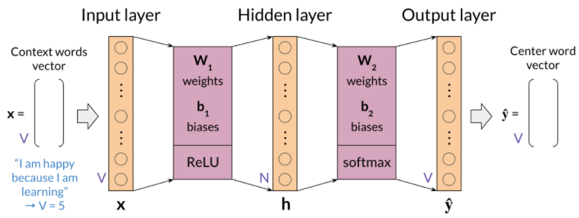
CBOW Model Architecture

Slide 17
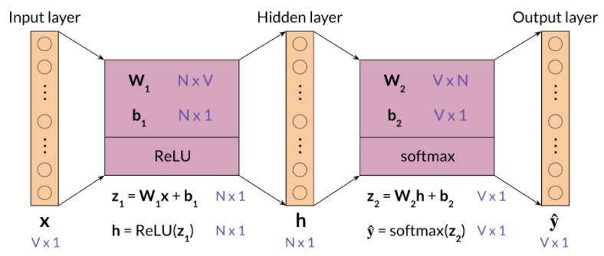
CBOW Model Architecture: Dimensions

Slide 18
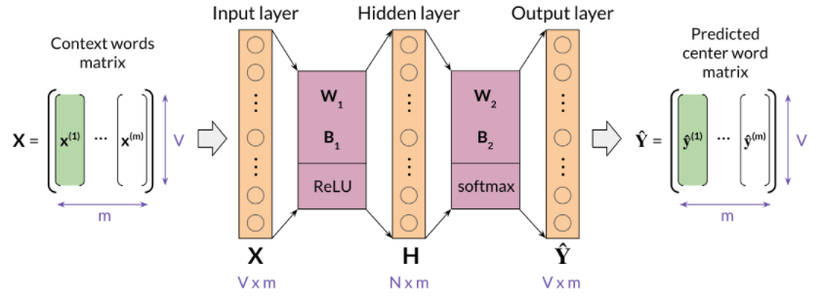
CBOW Model Architecture: Dimensions

Slide 19
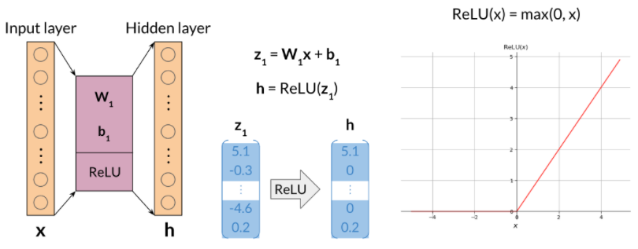
CBOW Model Architecture: ReLU function

Slide 20
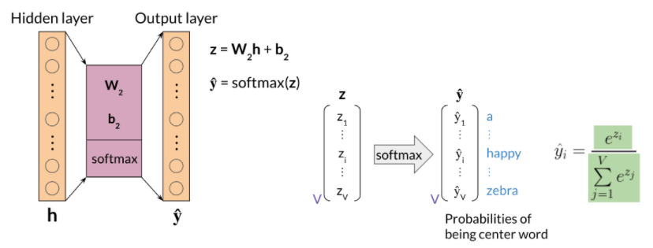
CBOW Model Architecture: Softmax Function

Slide 21
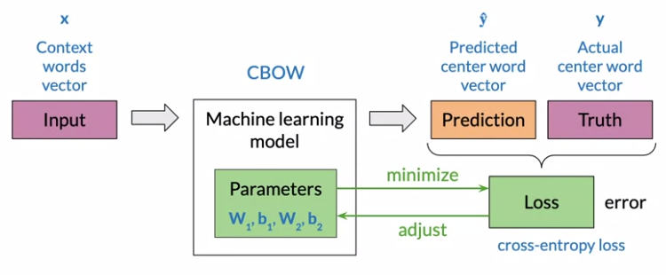
Training a CBOW Model: Cost Function

Slide 22

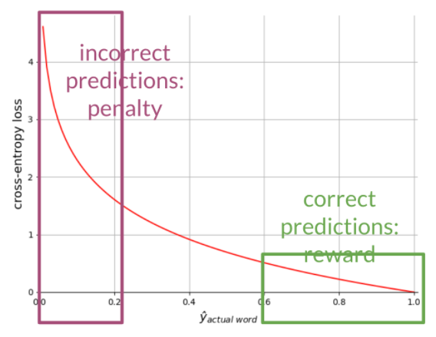
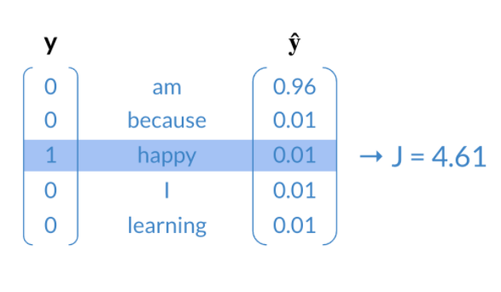
Training a CBOW Model: Cost Function
The cost function for the CBOW model is a cross-entropy loss defined as:

Slide 23

Training a CBOW Model: Cost Function
The cost function for the CBOW model is a cross-entropy loss defined as:

Slide 24
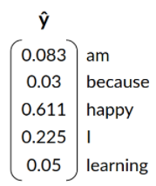
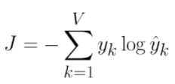
Question
For a given training example, the output of a CBOW model is the vector ŷ below, predicting “happy” as the center word. The actual center word was “learning”. What is the cross-entropy loss for this example?
0.49
2.99
1.49
2.49

Slide 25
Question
For a given training example, the output of a CBOW model is the vector ŷ below, predicting “happy” as the center word. The actual center word was “learning”. What is the cross-entropy loss for this example?
0.49
2.99
1.49
2.49

Slide 26
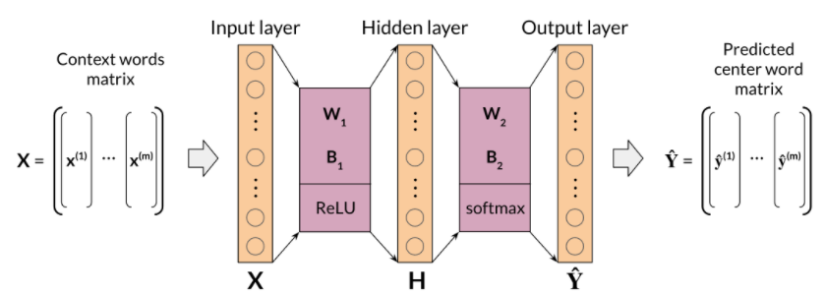
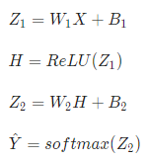
Training a CBOW Model: Forward Propagation
In the image below you start from the left and you forward propagate all the way to the right.

Slide 27
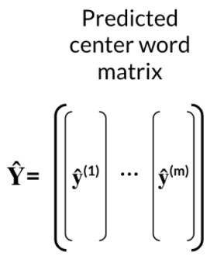
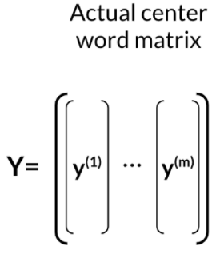

Training a CBOW Model: Forward Propagation
Given, your predicted center word matrix, and actual center word matrix, you can compute the loss.
To calculate the loss of a batch, you have to compute the following:

Slide 28
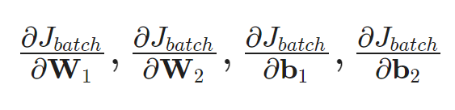
Training a CBOW Model: Backpropagation
Calculate partial derivatives of cost with respect to weights and biases.
When computing the back-prop in this model, you need to compute the following:

Slide 29
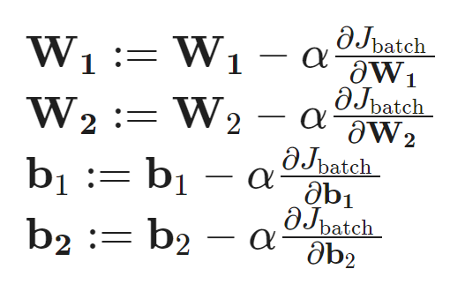
Training a CBOW Model: Gradient Descent
Update weights and biases
To update the weights you can iterate as follows:

Slide 30
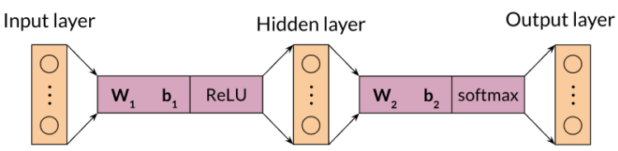
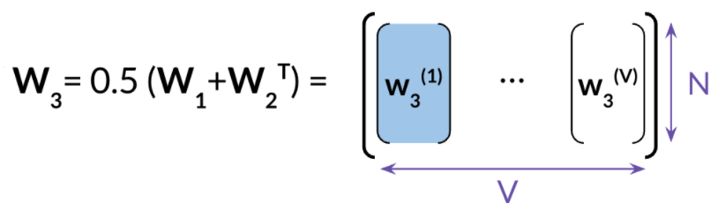
Extracting Word Embedding Vectors

Slide 31
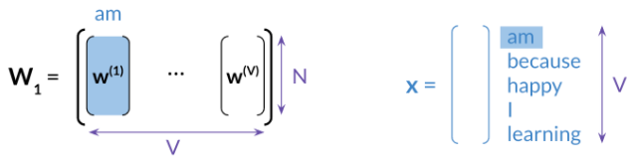
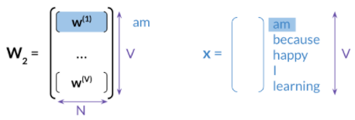
Extracting Word Embedding Vectors

Slide 32
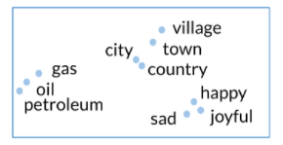
Evaluating Word Embeddings: Intrinsic Evaluation
We can perform intrinsic evaluation to test relationships between words and capture:
Semantic analogies:
“France” is to “Paris as “Italy” is to <?>
Syntactic analogies:
“seen” is to “saw” as “been” is to <?>
We can do clustering and visualization

Slide 33
Evaluating Word Embeddings: Extrinsic Evaluation
Extrinsic evaluation test embeddings on external tasks like named-entity recognition, parts-of-speech tagging…
This method is better as it evaluates the usefulness of the word embeddings
Time consuming
Difficult to troubleshoot

